Slide 1
Gazebo Quick start

Slide 2
Overview and Installation
http://gazebosim.org/tutorials?cat=guided_b&tut=guided_b1
Understanding the GUI
http://gazebosim.org/tutorials?cat=guided_b&tut=guided_b2
Model Editor
http://gazebosim.org/tutorials?cat=guided_b&tut=guided_b3

Slide 3
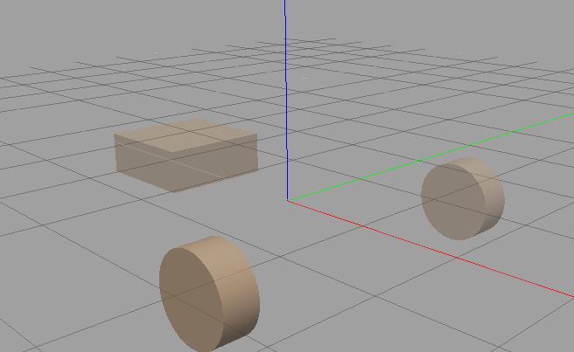
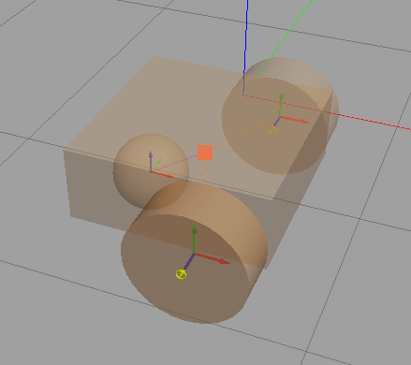
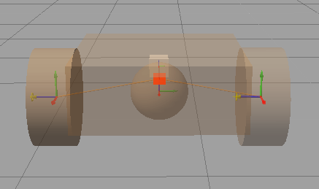
Vehicle construction

Slide 4
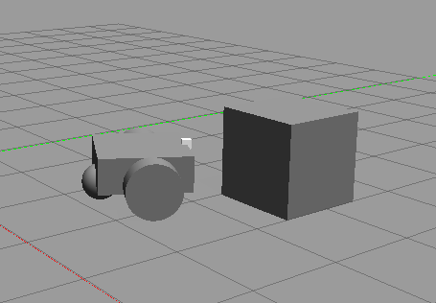
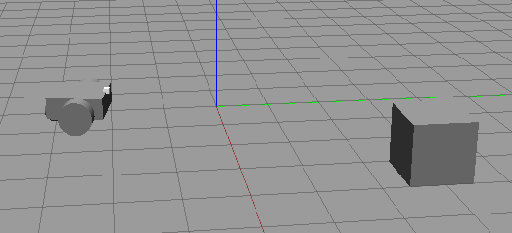
Simulation (Follower)

Slide 5
Install gazebo ros pachage
http://gazebosim.org/tutorials?tut=ros_installing&cat=connect_ros#TestingGazebowithROSIntegration

Slide 6
Run Gazebo
http://gazebosim.org/tutorials?tut=quick_start#RunGazebo
Could not load robot

Slide 7
Using roslaunch to start gazebo
http://gazebosim.org/tutorials?tut=ros_roslaunch
1- use roslaunch to open gazebo
2- change roslaunch arguments

Slide 8
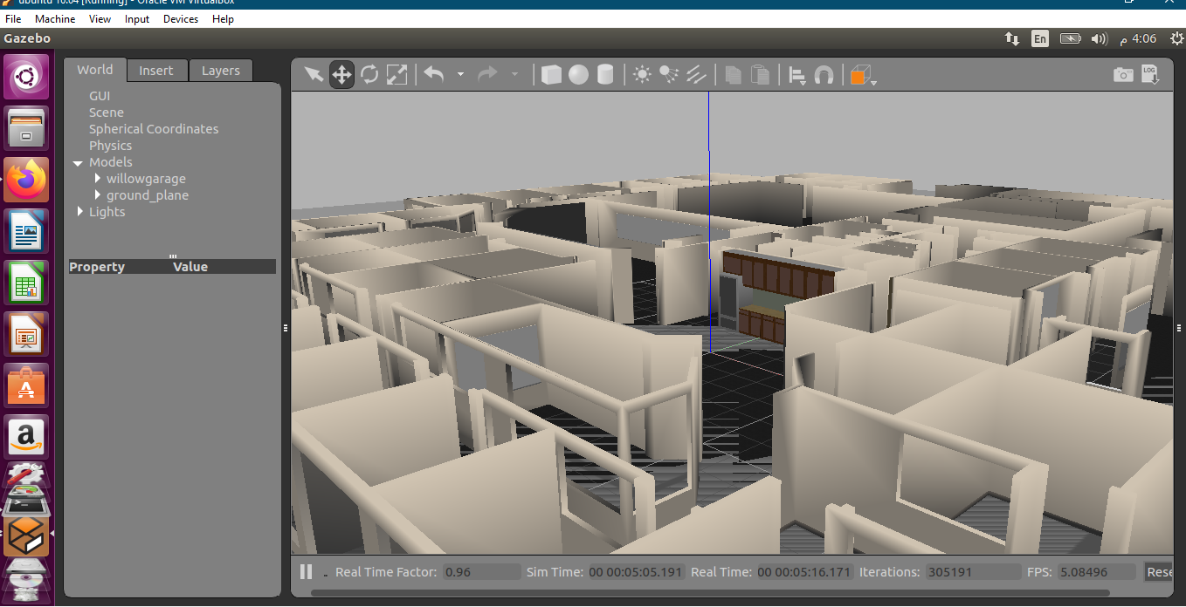
Roslaunch demo worlds (willowgarge)

Slide 9
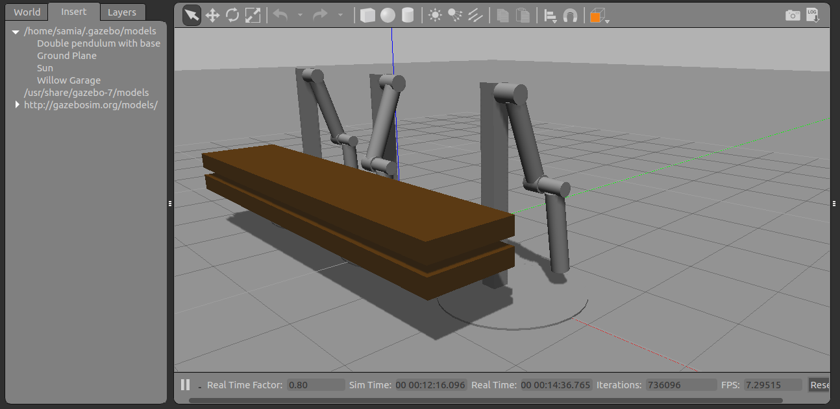
Roslaunch demo worlds (mud)
All parameters in arabic

